Slide 1


DEPARTMENT OF AUTOMOBILE ENGINEERING
MIT CAMPUS, ANNA UNIVERSITY, CHENNAI – 44
FINAL REVIEW
S.No | Name | Register Number
1 | NIROSHINI. K | 2019502032
2 | AKILAN. S | 2019502509
3 | DHINESH BABU. R | 2019502517
4 | HARI VIGNESH. N S | 2019502523
GUIDE:
Dr. A.Sangeet Sahaya Jeyangel,
Teaching Fellow,
Department of Automobile Engineering,
MIT campus, Anna university

Slide 2
TITLE
EXPERIMENTAL ANALYSIS OF PERFORMANCE,COMBUSTION AND EMISSION CHARACTERISTICS OF SINGLE CYLINDER DIESEL ENGINE USING BIODIESEL (DIESEL-TURPENTINE BLEND) WITH HYDROGEN INDUCTION.

Slide 3
INTRODUCTION
Entire worldwide, fossil reserves are getting scantier and progressively exorbitant with time.
Moreover, constant dependency on them leads to the frightening plight of global warming. Higher fuel prices and limited natural resources have forced the researchers to pursue research on green alternative fuels.
The use of biodiesel obtained from plants in internal combustion engine is finding its place to replace the use of conventional fuel. In our research, the performance, combustion and emission characteristics of diesel engine fueled with biodiesel (diesel-turpentine blend) with hydrogen induction.

Slide 4
LITERATURE SURVEY
SI NO | JOURNAL NAME | YEAR | TOPIC | AUTHORS | INFERENCE
1 | Elsevier | 2019 | Experimental study on the effect of cetane improver with turpentine oil on CI engine characteristics | A.K.Jeevanantham, D.Madhusudan reddy,B.Ashok, Aman kumar | A novel cetane improver called SC5D is added with 20% blend of turpentine with diesel. For higher Nox emission condition,10% of EGR is applied. At this condition, unburned HC and smoke emissions are remarkably lower.
2 | Researchgate | 2017 | A review on novel bio-fuel from turpentine oil | Mehmet Hakki Alma, Tufan Salan | At 40% blend of turpentine oil with diesel mixture shows 2.5% increase in BTE than the diesel. nearly 50% smoke was reduced but a little shoot and co was found.

Slide 5
SI NO | JOURNAL NAME | YEAR | TOPIC | AUTHORS | INFERENCE
3 | Elsevier | 2018 | Influences of dual bio-fuel (Jatropha biodiesel and turpentine oil) on single cylinder variable compression ratio diesel engine | Pankaj Dubey, Rajesh Gupta | Experiments have been accompanied at CR of 15.5:1,17:1,18.5:1 and 20:1. Biofuel blend (JBT50) resulted at full load and CR 20:1,there was 2.17% increase inBTEand13.04%,17.5%,4.21% and 30.8% decrease in CO,HC, NOx and smoke and 11.04% increase in CO respectively.
24 | Elsevier | 2010 | Performance and exhaust emission of turpentine oil powered direct injection diesel engine | B. Prem Anand, C.G. Saravanan, C. Ananda Srinivasan | 30% of turpentine oil blend with diesel produce high brake power and net heat release rate with a net reduction in CO,HC,Nox,smoke and particulate matter. 40% and 50% blends produce lower brake power.

Slide 6
RESEARCH GAP
A review on novel bio-fuel from turpentine oil by Mehmet Hakki Alma, Tufan Salan (2017) - has discussed about the use of 40% of turpentine oil blend with diesel in diesel engine.
Influences of dual bio-fuel (Jatropha biodiesel and turpentine oil) on single cylinder variable compression ratio diesel engine by Pankaj Dubey, Rajesh Gupta (2018) – has discussed about the use of jatropha and turpentine oil blend in single cylinder diesel engine.
But so far no one has explored the arena of using hydrogen induction with turpentine blend with diesel biodiesel and analyzing the performance, combustion and emission characteristics of single cylinder ci engine.

Slide 7
AIM & OBJECTIVE
To experimentally test the performance , combustion , emissions characteristics of single cylinder diesel engine using biodiesel.
Objective is to compare the characteristics of biodiesel blends(diesel-turpentine) and the same with hydrogen induction.

Slide 8
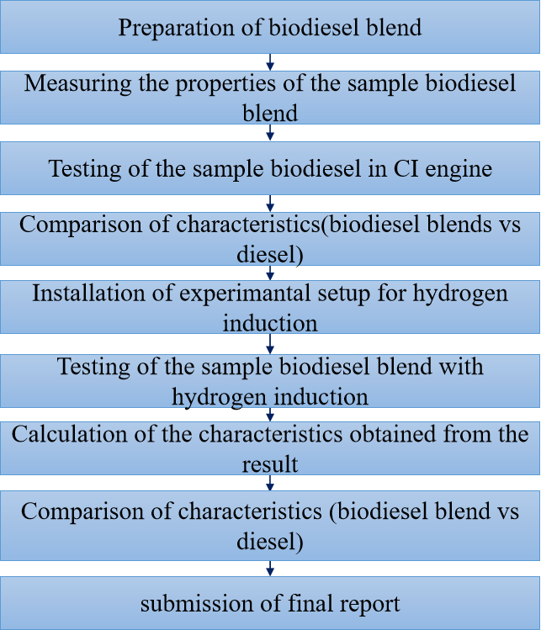
METHODLOGY

Slide 9
WHY TURPENTINE OIL?
Turpentine oil is physically a yellowish, opaque, odorous and water-immiscible liquid when it is chemically flammable,volatile and combustible.
Turpentine oil is mixture of α- and β- pinenes(30% and 60% respectively) and other isometric terpenes.
Turpentine oil is extracted from the resin of pine tree(genus pinus) saps and leaves.
Turpentine oil having low viscosity and lower carbon resides and environmentally friendly due to its low Sulphur content Also, the properties of turpentine oil are similar with diesel.

Slide 10
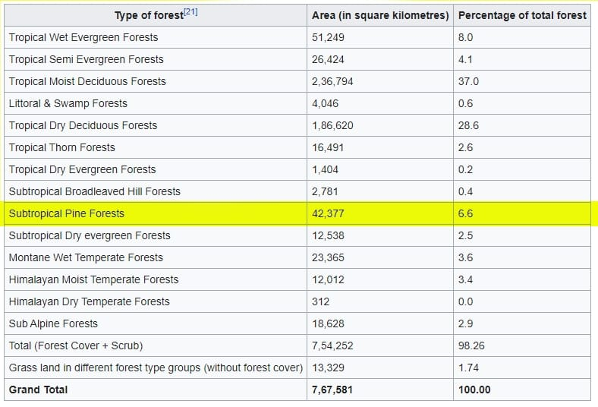
PINE TREE GROWTH IN INDIA

Slide 11
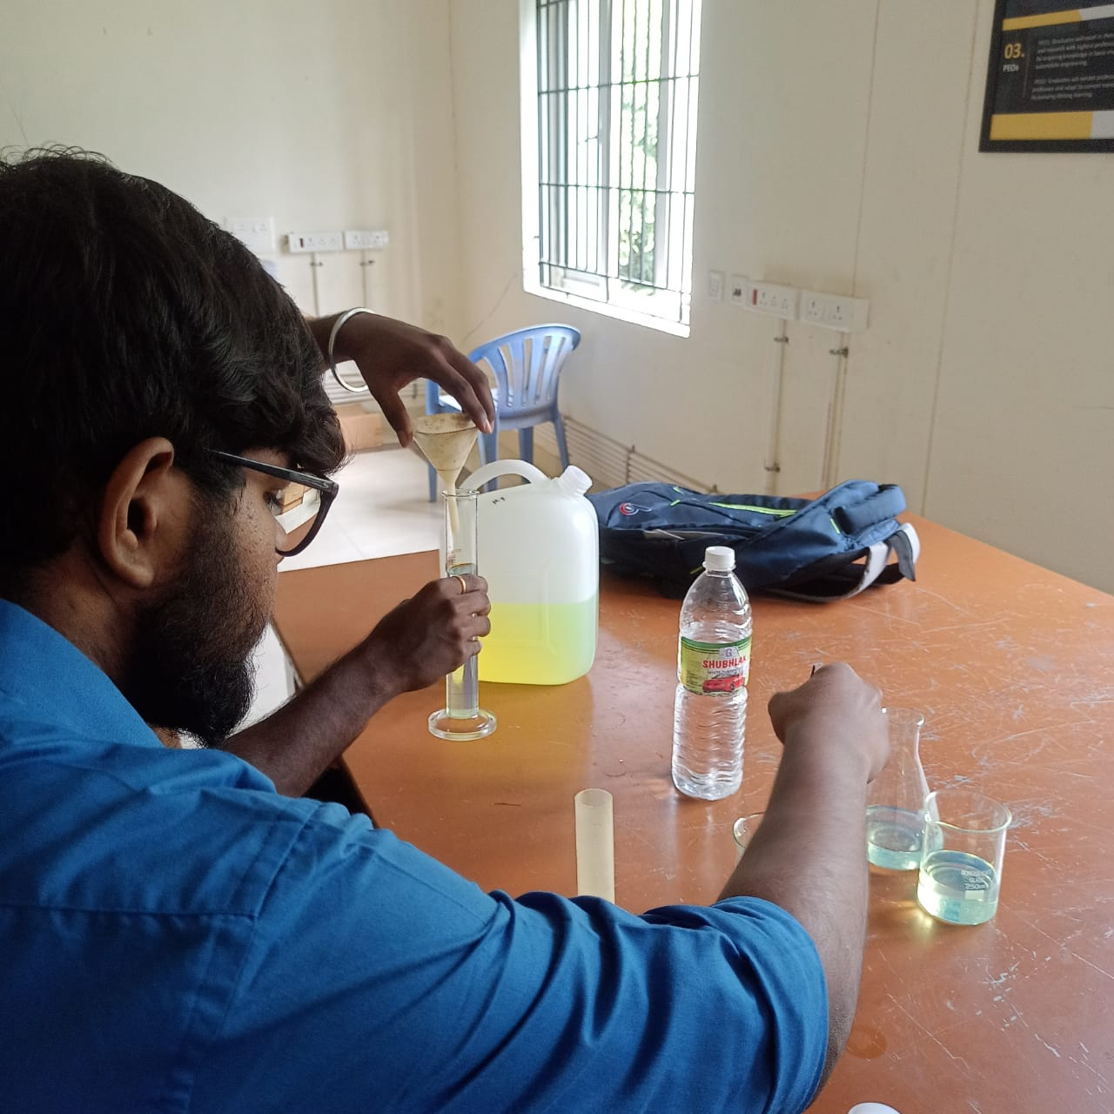
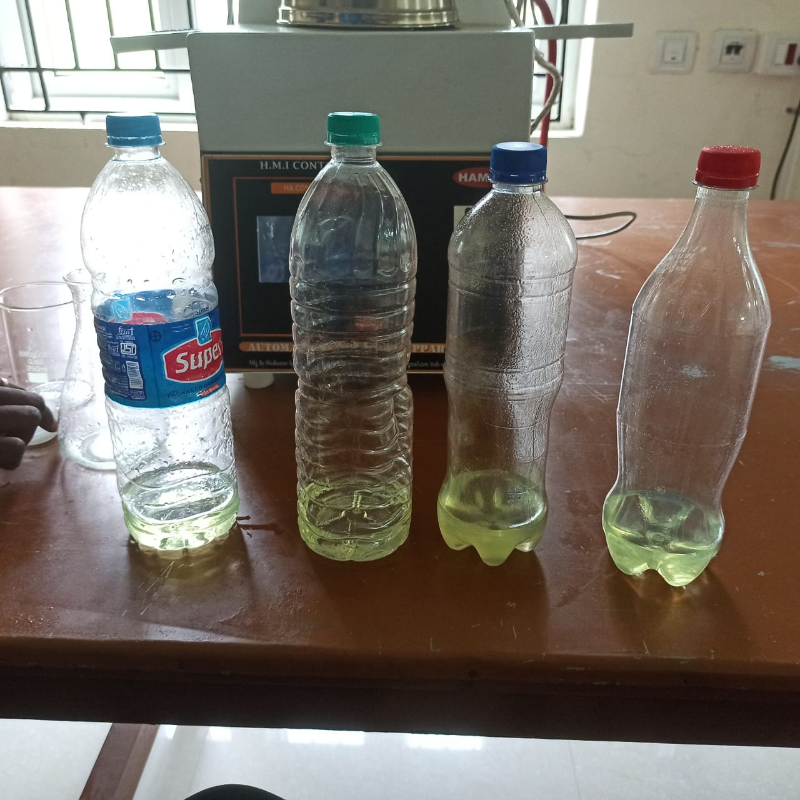
PREPARATION OF BIODIESEL(DIESEL-TURPENTINE BLEND)
4 BLENDS:
B20 (20%TURPENTINE 80%DIESEL)
B30 (30%TURPENTINE 70%DIESEL)
B40 (40%TURPENTINE 60%DIESEL)
B50 (50%TURPENTINE 50%DIESEL)

Slide 12
PROPERTIES OF BIO DIESEL BLENDS
Properties of Turpentine biodiesel which are close to Diesel:
DENSITY:
The density of material shows the denseness of that material in a specific given area. A material’s density is defined as its mass per unit volume.
Density is essentially a measurement of how tightly matter is packed together. It is a unique physical property for a particular object
The formula used to calculate the density is,
DENSITY = MASS/VOLUME
Unit = kg/m³

Slide 13
DENSITY

Slide 14
FLASH AND FIRE POINT
FLASH AND FIRE POINT:
The flash point is the lowest temperature at which a volatile substance evaporates to form an ignitable mixture with air in the presence of an igneous source and continues burning after the trigger source is removed.
Flash point is a significant property not for the operability of a diesel fuel, but for its storage and handling.
The fire point is defined as the lowest temperature at which vapors of the material will catch fire and continue burning even after the ignition source is removed. The fire point is higher than the flash point because the vapors produced at the flash point are not sufficient enough to ignite the fuel.

Slide 15
FLASH AND FIRE POINT

Slide 16
KINEMATIC VISCOSITY
KINEMATIC VISCOSITY:
The kinematic viscosity is an important fuel property which affects the atomization of a fuel upon injection into the combustion chamber.
REDWOOD VISCOMETER is used to measure the kinematic viscosity.
Hence, as the viscosity is less, the fuel is atomized properly, resulting in a complete combustion and good engine performance.
The formula to calculate the kinematic viscosity is,
Kinematic viscosity = AR – B/R (m²/s)
where,
A & B are viscometer constants A = 0.26 ,B = 171.5
R = time in second for collection of 60 cc of oil in the flask.

Slide 17
KINEMATIC VISCOSITY

Slide 18
PROPERTIES OF FUEL
BLEND | DENSITY(kg/m³) | KINEMATIC VISCOSITY ( m²/s) | FLASH POINT (°c) | FIRE POINT (°c)
DIESEL | 0.827 | 13.28 | 47 | 54
B20 | 0.831 | 14.567 | 49 | 55
B30 | 0.835 | 14.147 | 52 | 57
B40 | 0.839 | 13.360 | 55 | 60
B50 | 0.844 | 13.055 | 57 | 62
TURPENTINE | 0.845 | 10.870 | 53 | 58

Slide 19
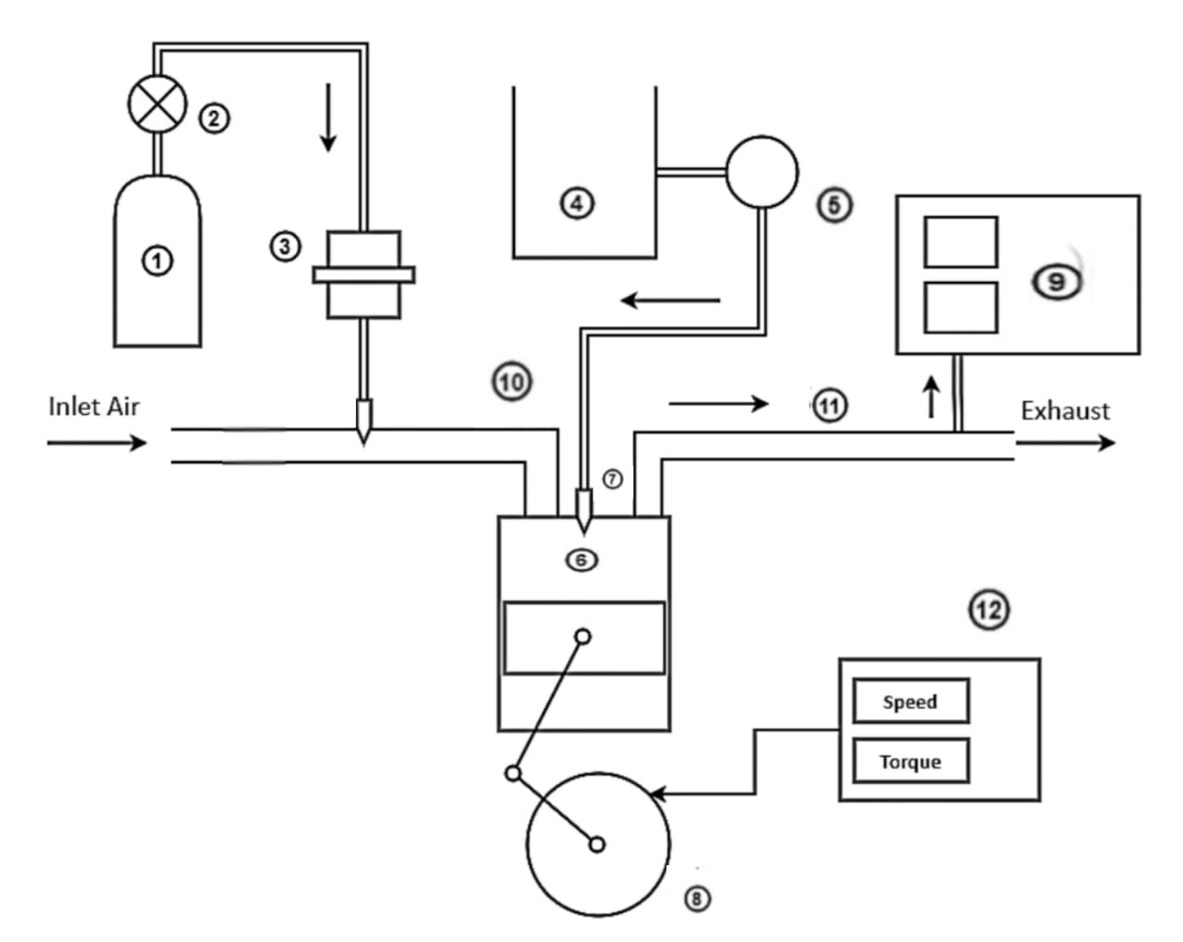
ENGINE LAYOUT
① - Hydrogen Storage Tank
② - Pressure Regulator
③ - Flame Arrestor
④ - biodiesel-Diesel blend tank
⑤ - Fuel Pump
⑥ - Diesel Engine
⑦ - Fuel Injector
⑧ - Crank Wheel
⑨ - Exhaust Gas Analyzer
⑩ - Inlet Manifold
⑪ - Exhaust Manifold
⑫ - Dynamometer

Slide 20
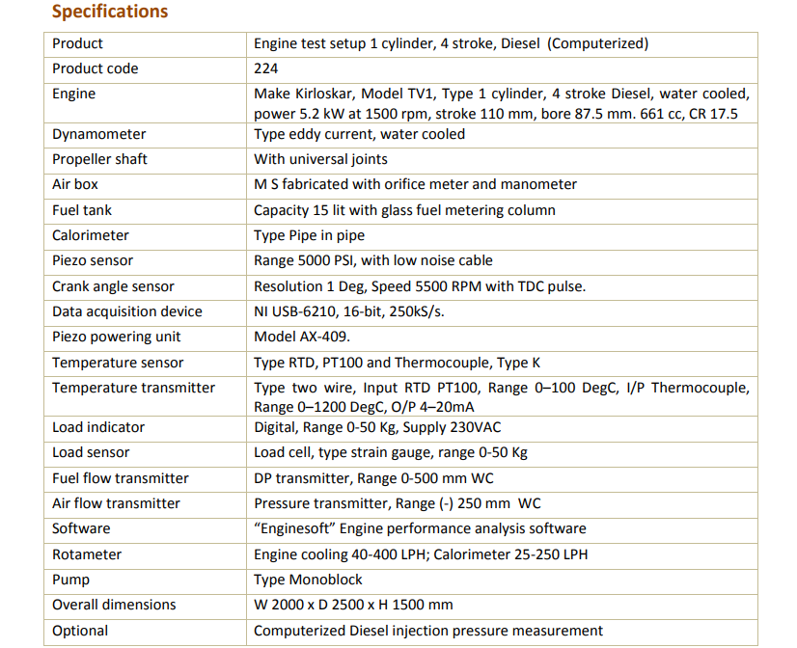
ENGINE SPECIFICATIONS

Slide 21
ENGINE DESCRIPTION and SOFTWARE USED
The setup consists of single cylinder four stroke diesel engine connected to the eddy current type dynamometer for loading.
Its provided with necessary instruments for combustion pressure and crank angle measurements.
EngineSoft is LabView based software package developed by APEX INNOVATIONS Pvt. Ltd for engine performance monitoring system.
It evaluates power efficiencies,fuel consumption and heat release.
It is configurable as per engine setup.
Various graphs are obtained at different operating conditions.

Slide 22
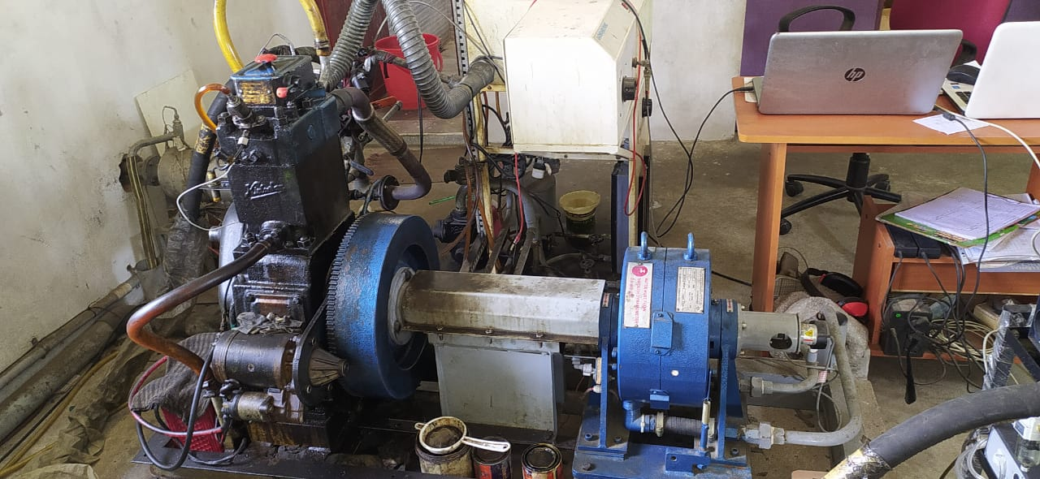

Slide 23
PERFORMANCE CHARACTERISTICS

Slide 24
BRAKE THERMAL EFFICIENCY

Slide 25
SPECIFIC FUEL CONSUMPTION

Slide 26
BTE VS BP

Slide 27
COMBUSTION CHARACTERISTICS

Slide 28
CRANK ANGLE VS HEAT RELEASE RATE

Slide 29
EMISSION CHARACTERISTICS

Slide 30
C02 AND NOx

Slide 31
SMOKE

Slide 32
EMISSION DATA

Slide 33
INFERENCES
PERFORMANCE CHARACTERICTICS:
BRAKE THERMAL EFFICIENCY:
BTE of bio diesel blends were less when compared to the diesel fuel because of the poor volatility and inferior combustion characteristics of the bio diesel blends.
At partial loads(50%), the BTE of B20,B30,B40 and B50 blends were found to be 27.02%,26.98%,26.74%,26.25% respectively.
At full loads(100%), the BTE of B20,B30,B40 and B50 blends were found to be 31.92%,31.71%,31.38%,30.89% respectively.
SPECIFIC FUEL CONSUMPTION:
The SFC was found to increased for the biodiesel blend when compared to the diesel.
At low loads,the SFC was found to be higher whereas when load increases the SFC was found to be similar for all the biodiesel blends and the diesel.

Slide 34
COMBUSTION CHARACTRISTICS
INCYLINDER PRESSURE:
The cylinder pressure generated by the bio diesel blends were less when compared to the diesel fuel. This is due to the poor calorific value which results in the inferior combustion.
The cylinder pressures of B20 and B30 were found to be greater among the bio diesel blends which were closer to the diesel.
HEAT RELEASE RATE:
The biodiesel releases less heat when compared with the diesel,due to the less calorific value of the biodiesel and less cylinder pressure.
Also the HRR is decreased due to the lower ignition delay of the biodiesel blends compared to the diesel fuel.

Slide 35
EMISSION CHARACTERISTICS
HC EMMISIONS:
The bio diesel blend contains more oxygen content which decreases the ignition delay. Therefore, the combustion will be incomplete which leads to the increase in HC emissions.
At partial loads,HC emissions were 63ppm,55ppm,44ppm,52 ppm for the B20,B30,B40,B50 blends respectively.
At full loads, the HC emissions were 81ppm,83ppm,65ppm,68 ppm respectively for the B20,B30,B40 and B50 blends.
CO EMISSIONS:
The CO emissions for the biodiesel were found to be higher than the diesel due to the oxygen content in the biodiesel.At low loads it is reduced but increases for higher loads.
At partial loads, the percentage CO were 0.047%,0.041%,0.068%,0.052% respectively for the B20,B30,B40 and B50 blends.
At full load,CO percentage were 0.155%,0.276%,0.215%,0.267% respectively for the B20,B30,B40 and B50 blend respectively.

Slide 36
EMISSION CHARACTERISTICS
CO2 EMISSIONS
The emissions of CO2 was found to be similar for all the biodiesel blends compared with the diesel fuel. This was due to the higher oxygen content.
At partial loads, the percentage of CO2 were found to be 6.25%,5.59%,6.37%,5.83% for the B20,B30,B40 and B50 blends respectively.
At full loads, the CO2 was found to be 10.2%,11.2%,11%,11.2% for the B20,B30,B40 and B50 blends respectively.
SMOKE EMISSIONS
The smoke emissions were found to be increased due to the incomplete combustion of the biodiesel fuel.
At partial loads the percentage of smoke was found to be 30.2%,31.6%,33.2%,35.6% for B20,B30,B40,B50 blends respectively.
At full loads, the smoke percentage were 64.6%,64.9%,65.6%,66.3% respectively for the B20,B0,B40 and B50 blends.

Slide 37
EMISSION CHARACTERISTICS
NOx EMISSIONS:
The NOx emissions were increased due to the higher combustion temperature.
Here the NOx emissions were lower at low loads and then gradually increases at high loads.
At low load(25%), The emissions of NOx were 618ppm,532ppm,525ppm,536 ppm respectively for B20,B30,B40 and B50 blends respectively.
At higher loads(100%), the NOx emissions were found to be 2142 ppm,2176 ppm,2322 ppm,2341 ppm respectively for B20,B30,B40 and B50 blends .

Slide 38
CONCLUSION
Various blends of turpentine-diesel blends namely B20,B30,B40,B50 were taken and tested for the performance, combustion and emission characteristics of single cylinder diesel engine.
The brake thermal efficiency was lower for the biodiesel blends when compared with the diesel fuel.
The specific fuel consumptions were also found to be increased.
The combustion pressure and the heat release rate were also found to be lower for the biodiesel blends.
The NOx and CO emissions were reduced at lower loads and found to be higher when the load increases.
Also It was found that the blends B20 and B30 were found to promising to have less emissions and higher brake thermal efficiency than the other blends.
So B20 and B30 blends were chosen for the further testings with hydrogen induction.

Slide 39
WORK FOR PHASE-2
Experimental setup for hydrogen induction in single cylinder diesel engine.
Testing of biodiesel with hydrogen induction
Comparison of characteristics of biodiesel blend and the same with hydrogen induction.
Submission of report.

Slide 40
THANK YOU

